Slide 1
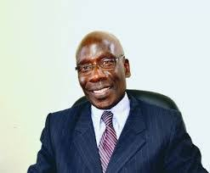
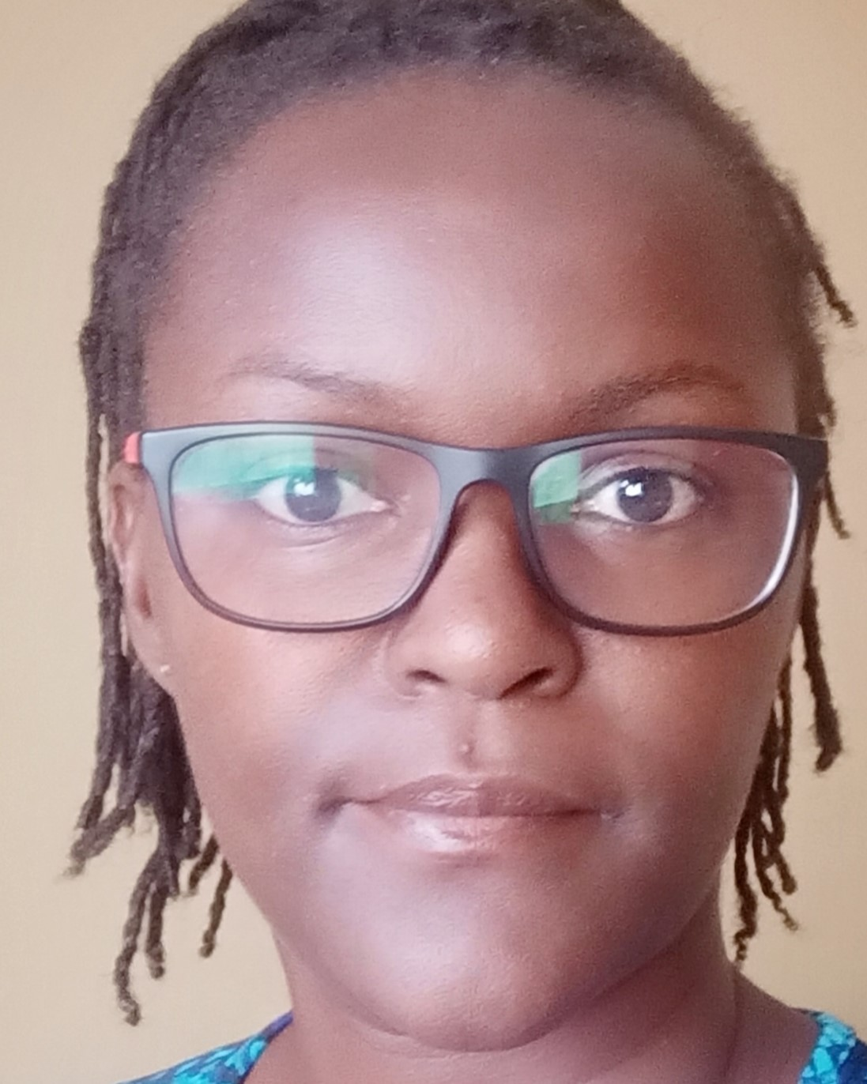
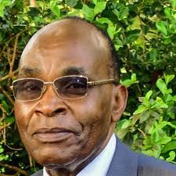
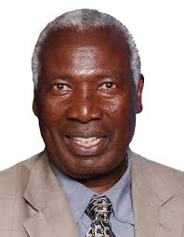
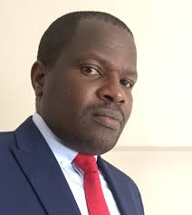
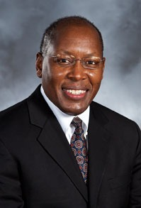
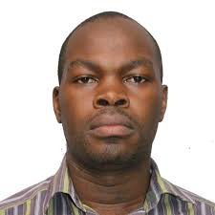
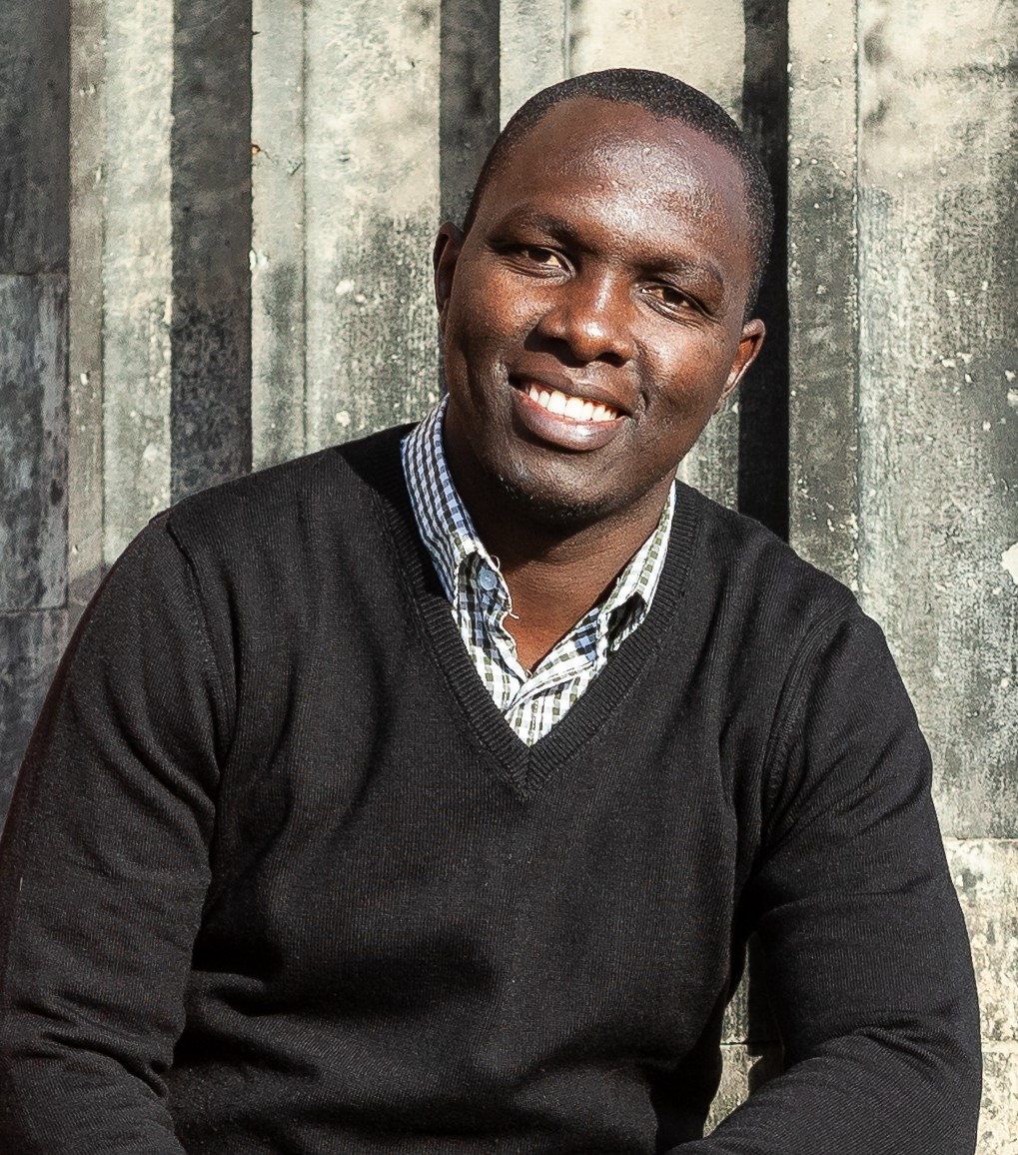
UON@50 WEBINAR (CELEBRATING 50 YEARS OF ACADEMIC EXCELLENCE)
Capacity Development in Agriculture for attainment of Food security, SDGs and Vision 2030 for Kenya: Opportunities for Early Career Scientists and Industry Needs
HOST
MODERATOR
KEY NOTE ADDRES
MAIN SPEAKER
Prof. Julius Ogengo
Deputy Vice Chancellor, Student Affairs, UoN
Nekesah T. Wafullah
Business Development manager at CropNuts Kenya Ltd
Prof. Jasper Imungii, Distinguished Professor at University of Nairobi, Faculty of Agriculture
Prof. Ratemo Michieka, Distinguished Professor at University of Nairobi, Faculty of Agriculture
WEBINAR LINK
https://bit.ly/3qfPndU
SAVE DATE!
3RD DECEMBER 2020
TIME 3.00PM
Meeting ID :81362381335
PASS CODE: 530607
PANELISTS
Dr. Erick Ogumo
Agriculture Specialist, International Finance Corporation (IFC)
Dr. George Kamande
Diamond V International
Iowa, USA
Mr. Jack Wanyonyi
Project Manager, Equator Kenya Ltd
Mr. Chadwick Digo
Nutrition - Scientist, Trainer & Consultant
Mr. Emmnauel Atamba Oriedo,
Food And Farming Systems Expert, CEO, APSID Consulting Company LTD

